Slide 1
RFIDefense
Group 11: Justin Farkas, Fiacre Indagiye Sibomana, Young Jung, Jake Mecimore, Charles Valdez

Slide 2
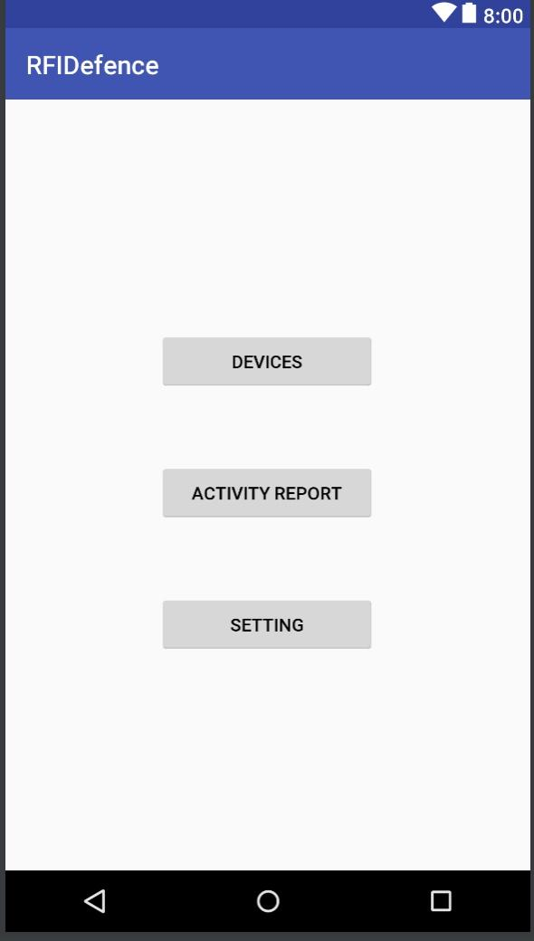
The Devices and RFID numbers associated with them
Shows Activity in real Time
General setting

Slide 3
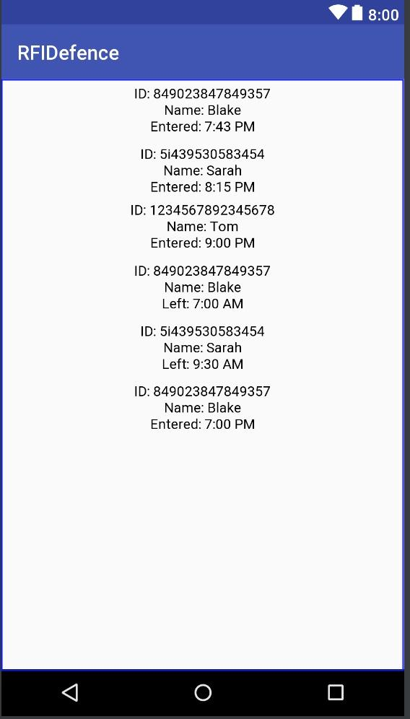

Slide 4
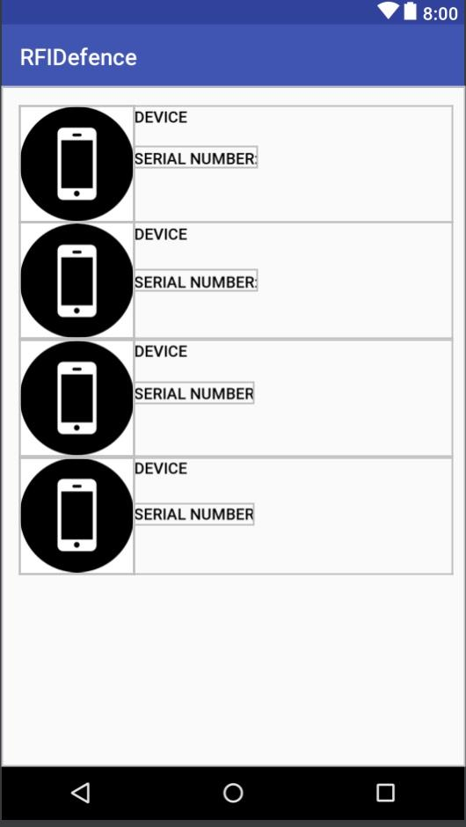
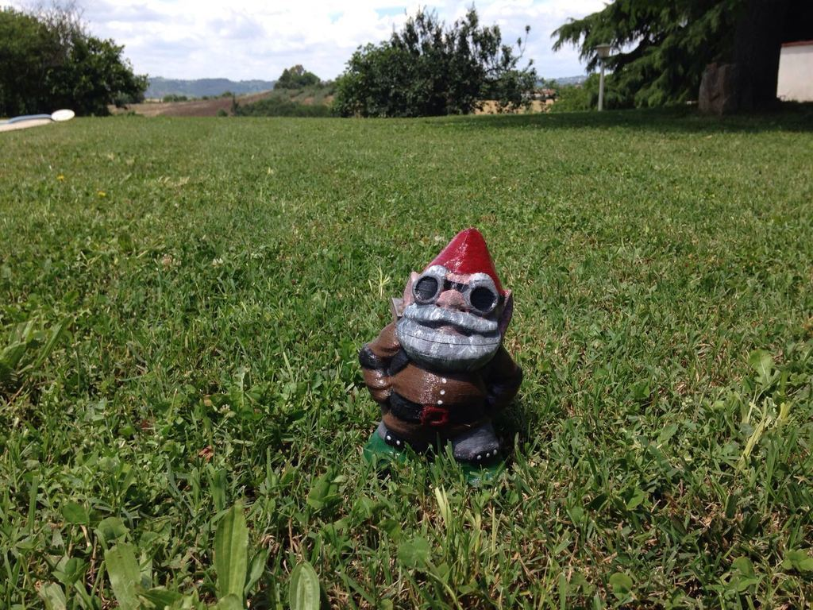
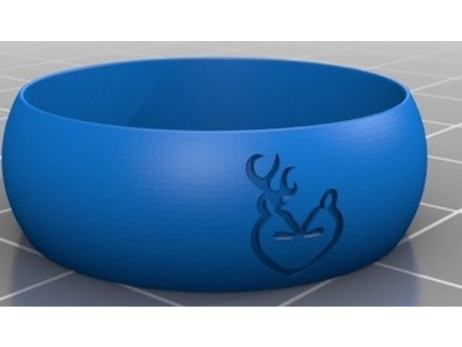

Slide 5
3D printable RFID devices

